Slide 1

Turnstile installation guide

Slide 2
1
Preparation
2
Installation
3
Content
Configuration
4
Self check

Slide 3

1
Preparation

Slide 4


1
Site survey
1. The barrier should be installed on the concrete or non-flammable ground, please check site situation to confirm whether can trench on the ground for interconnect and network cables. If not allowed, please purchase base for barriers
2. Ensure the ground is smooth so that turnstile can work normally
Base example
Standard scenario example

Slide 5
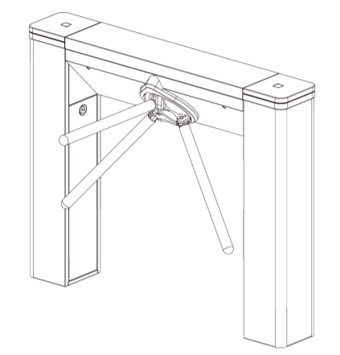
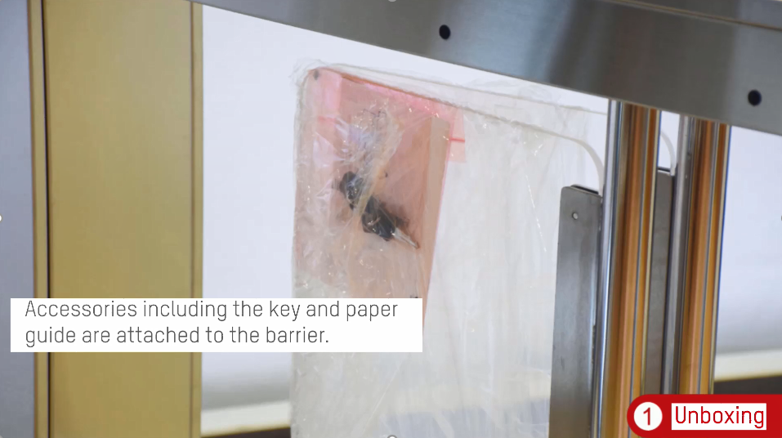
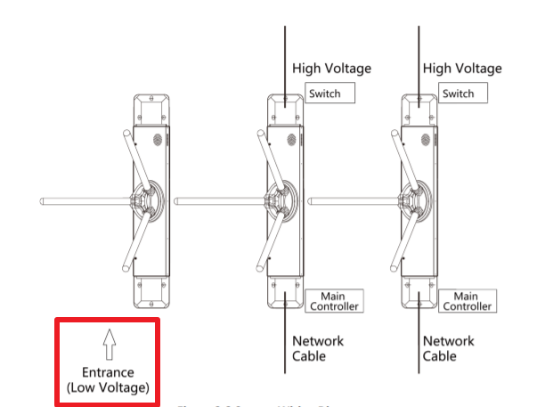
1
Unboxing
Step 1. Remove the package, foam protection and plastic film
Step 2. Check accessories(the key and paper guide)
1
Step 3. check entrance direction

Slide 6
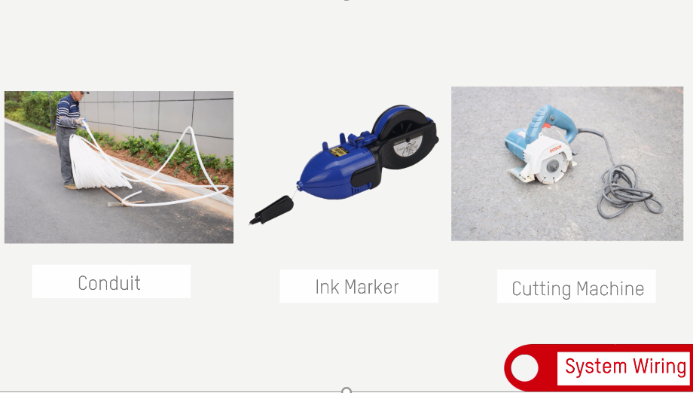

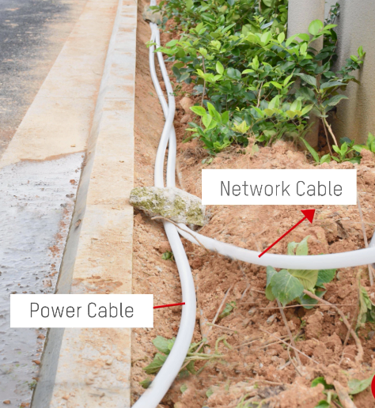
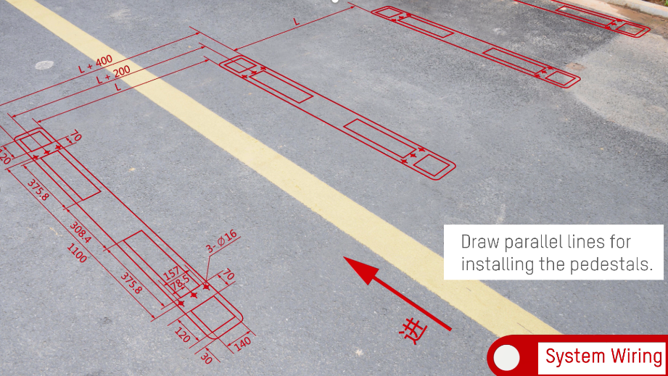
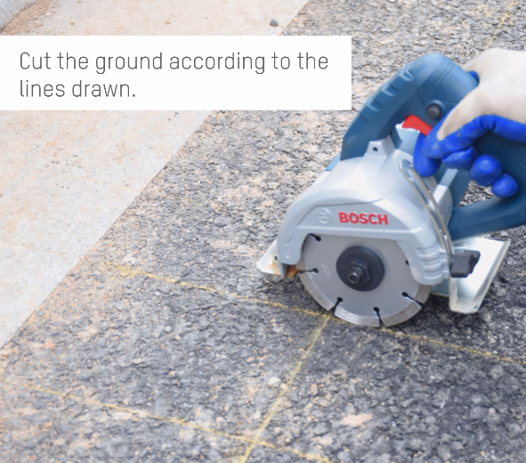
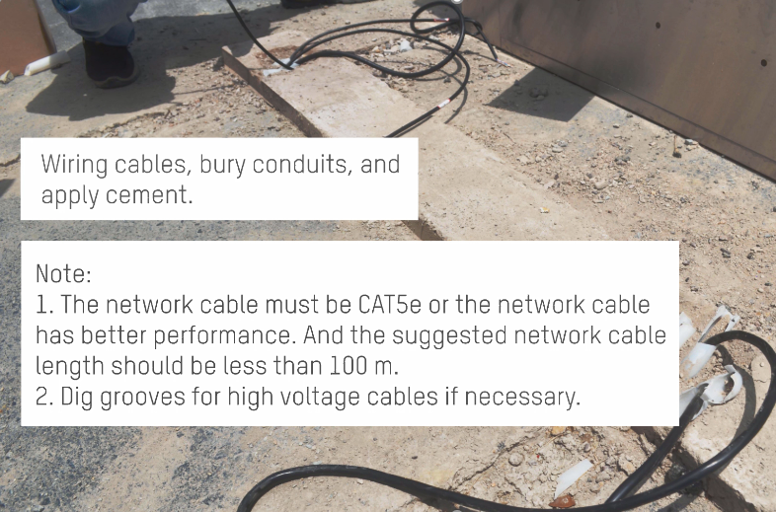
1
System wiring
Step 1. prepare tool :conduit, ink marker ,cutting machine，network cable(CAT6 suggested),
3-core power cable for 220V/110V AC power
Step 2.dig grooves, bury cables(network cable, power cable in saperate conduit )
Step 3. draw line for installing the pedestal and lay out the cable (refer diagram of next page to draw line)
Step 4.cut the ground according to the lines drawn
Step 5.wiring cables,bury conduits and apply cement

Slide 7
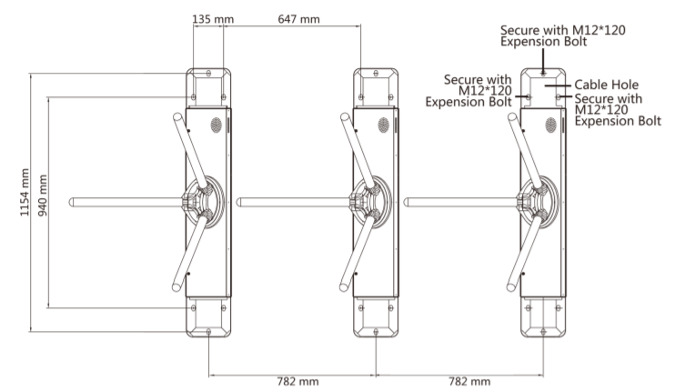
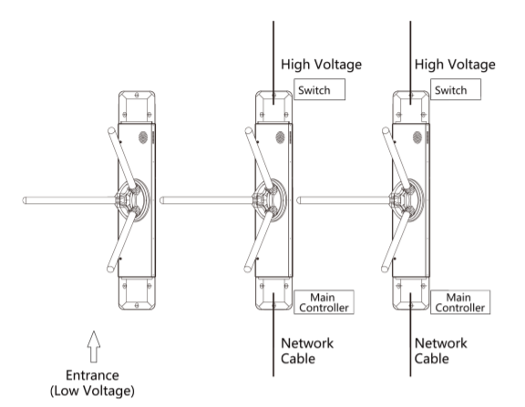
1
System wiring

Slide 8
2
Installation

Slide 9
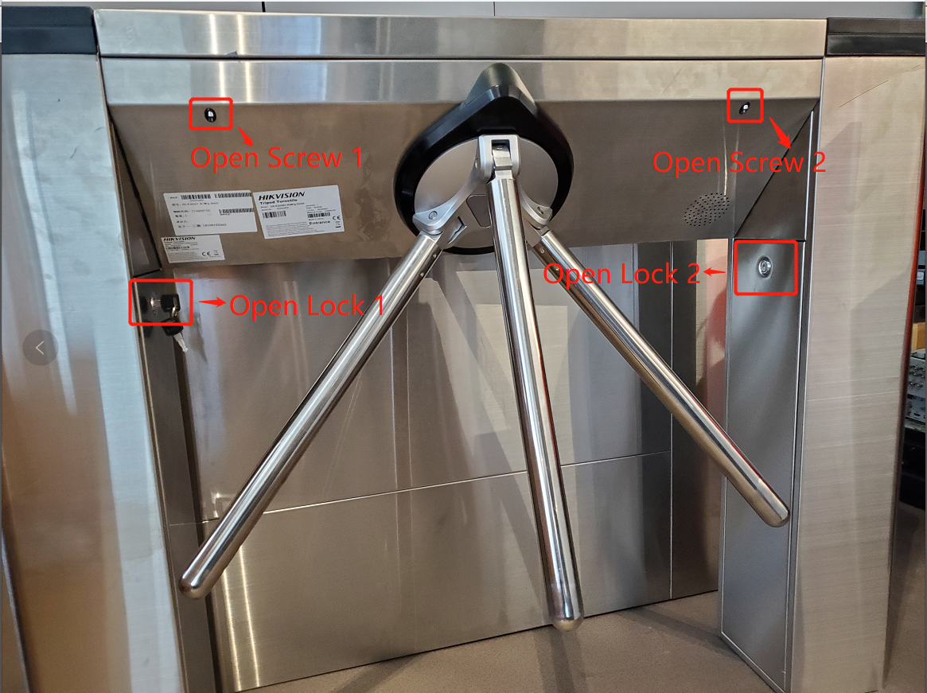
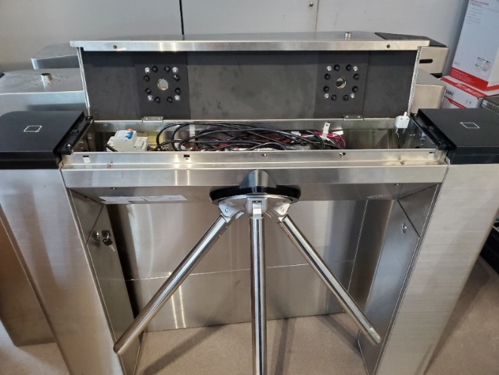
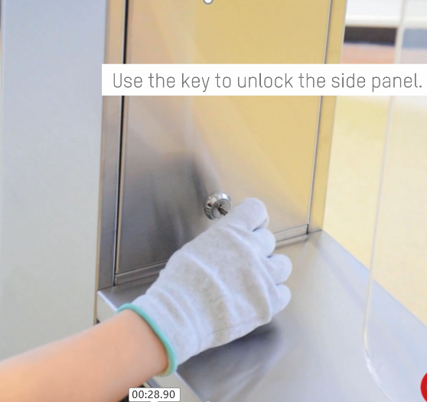
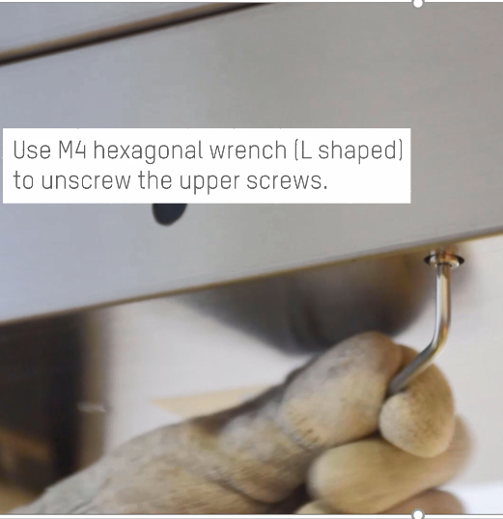
2
Disassemble turnstile-I
1.Open side lane cover by key to connect AC power and network cable through.Then fix the turnstile with expansion screw
2. Unscrew the upper cover plate with Allen key inside package, open the upper cover plate to connect MinMoe’s power, RS-485 cable and network cable

Slide 10
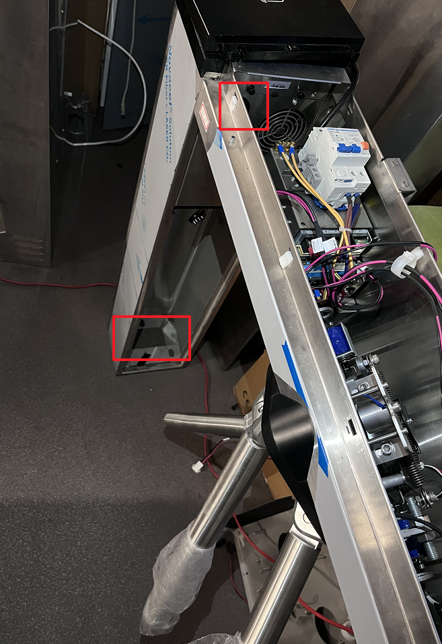
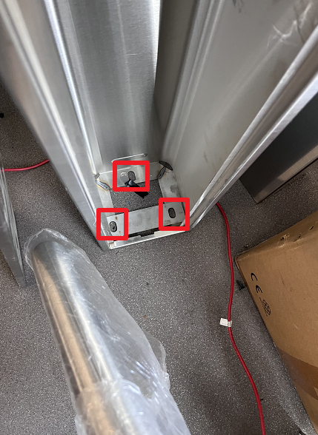
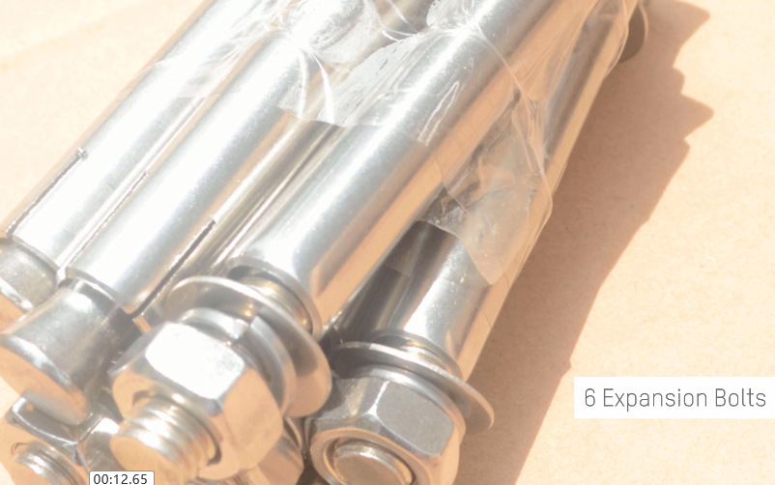
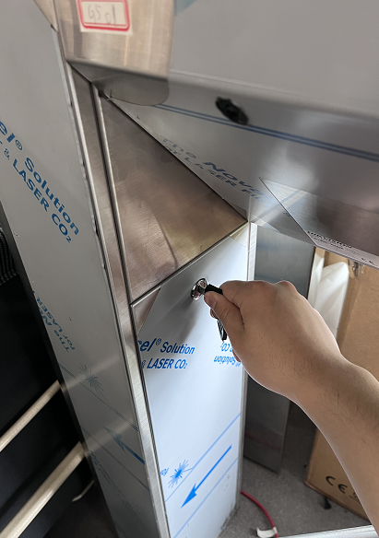
2
Install turnstile
Cable holes
Expansion bolt holes
Step 1.prepare tool :6 expansion bolts, screw driver
Step 2.Place the turnstile, smooth the cable through cable hole
Step 3.Pull cable through the hole, fix turnstile with enpansion bolts
Step 4. put back side panel back

Slide 11
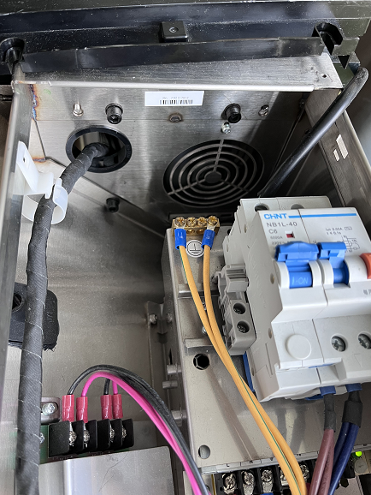
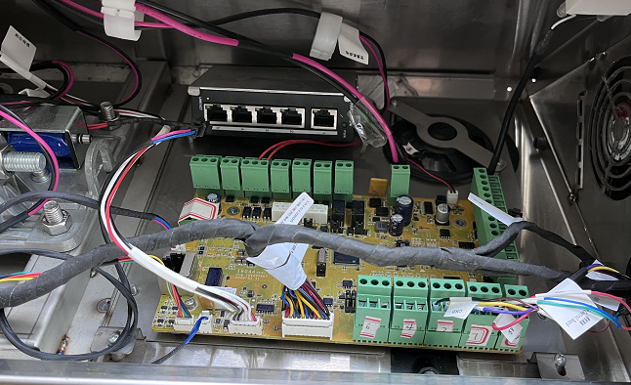
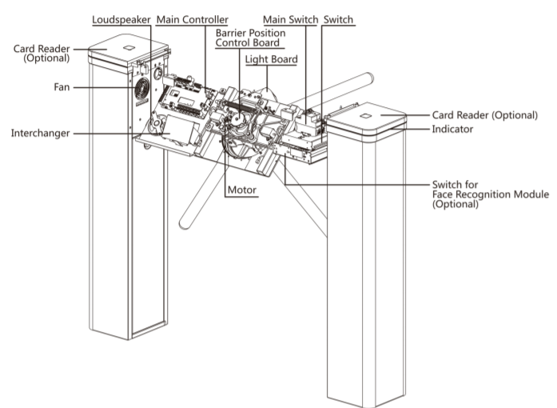
2
Components introduction

Slide 12
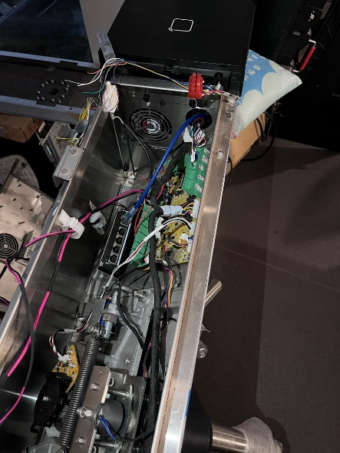
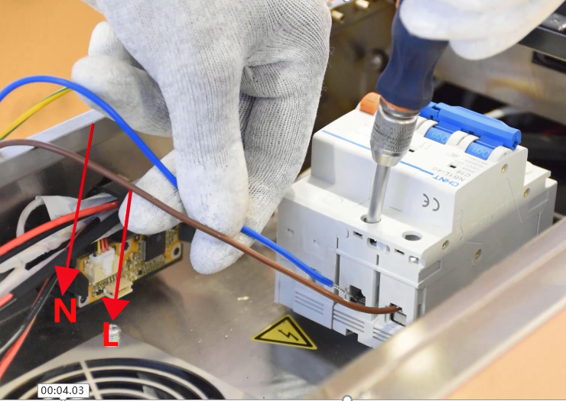
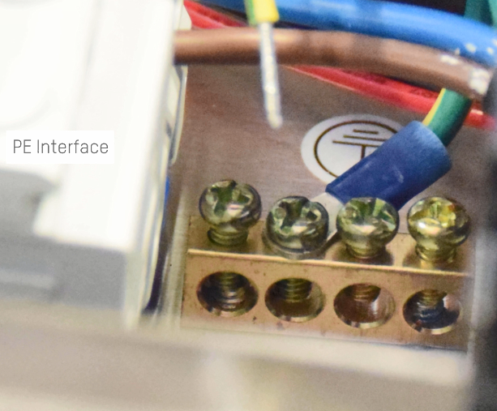
2
Wire power & network cable of turnstile
Cable hole
Pull out the AC power cable from the conduit through the cable hole and connect to air switch
Pull out the network cable from the conduit through the cable hole and connect to PoE switch

Slide 13
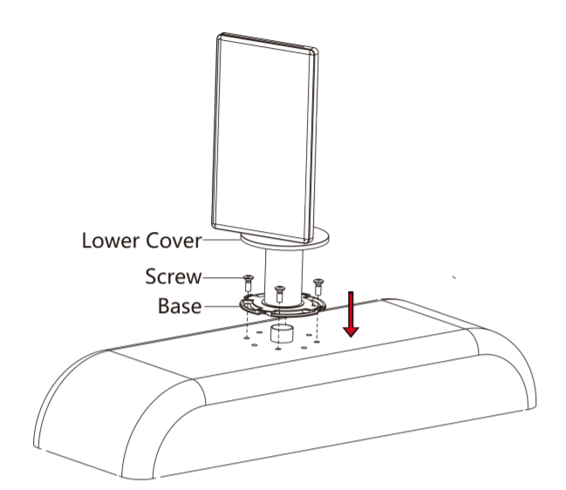
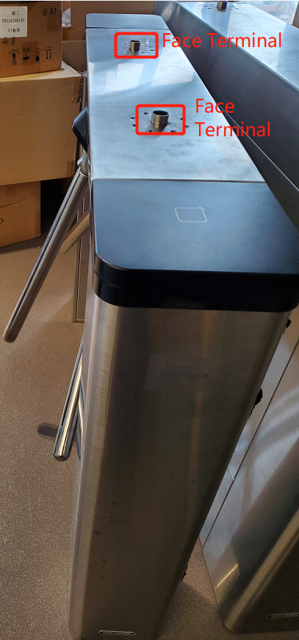
2
Installation for MinMoe
Lead cable of minmoe through open hole on the upper cover
Install the MinMoe with screws

Slide 14
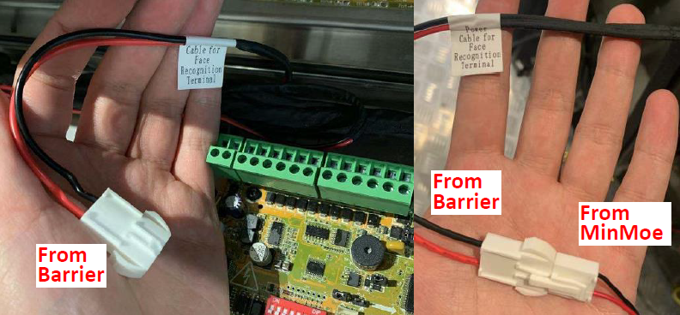
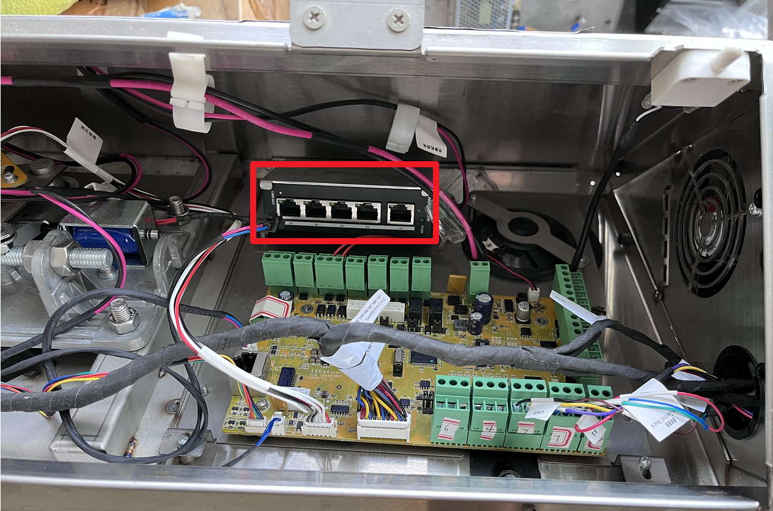
2
Wire power & network cable for MinMoe
Connect built in 12 power cable from turnstile with power port of MinMoe
Connect network cable between
MinMoe and network switch on
turnstile

Slide 15
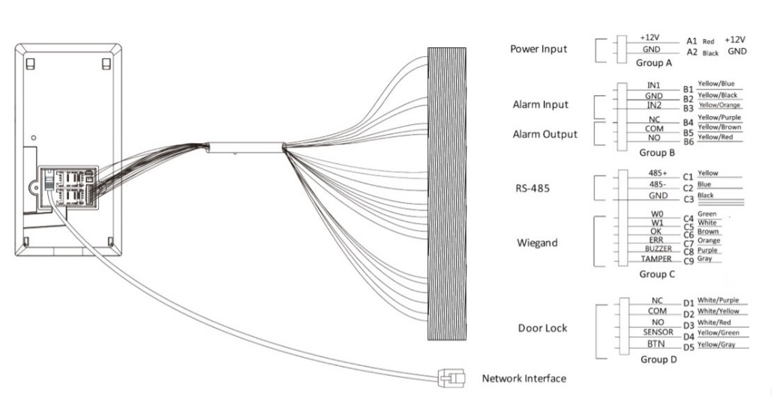
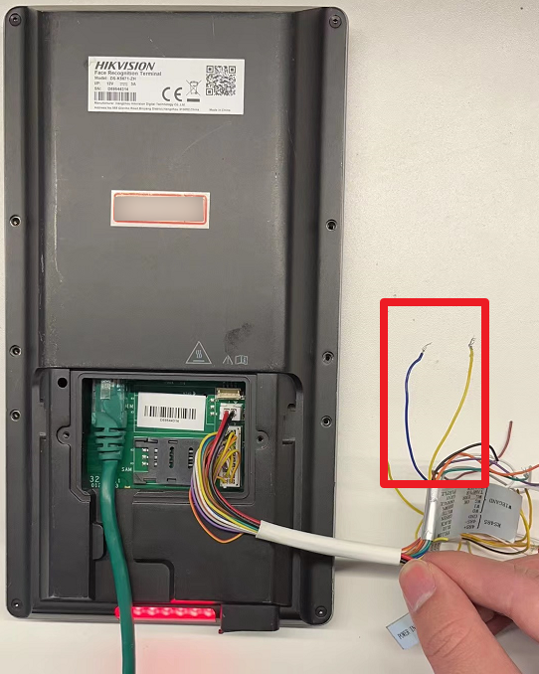
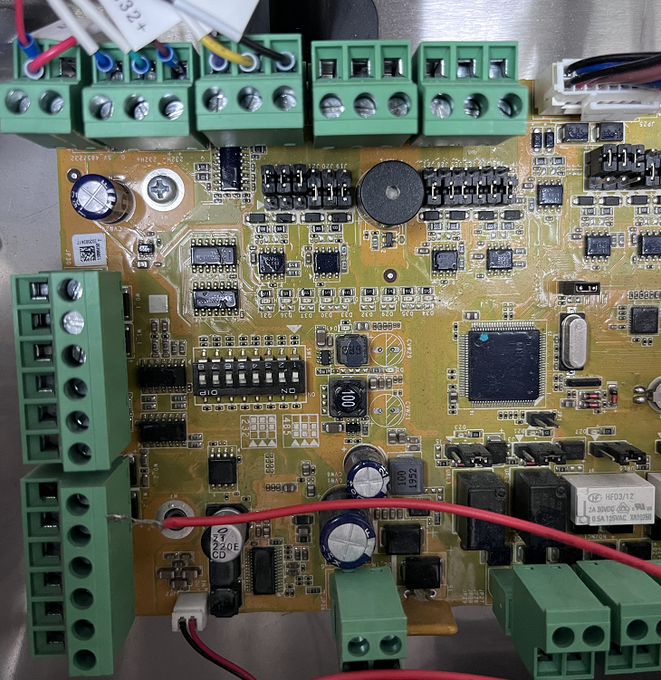
2
Wiring RS-485 cable for MinMoe
485D
485D
Connect 485 terminal of entrance /exit MinMoe to 485D port of turnstile

Slide 16
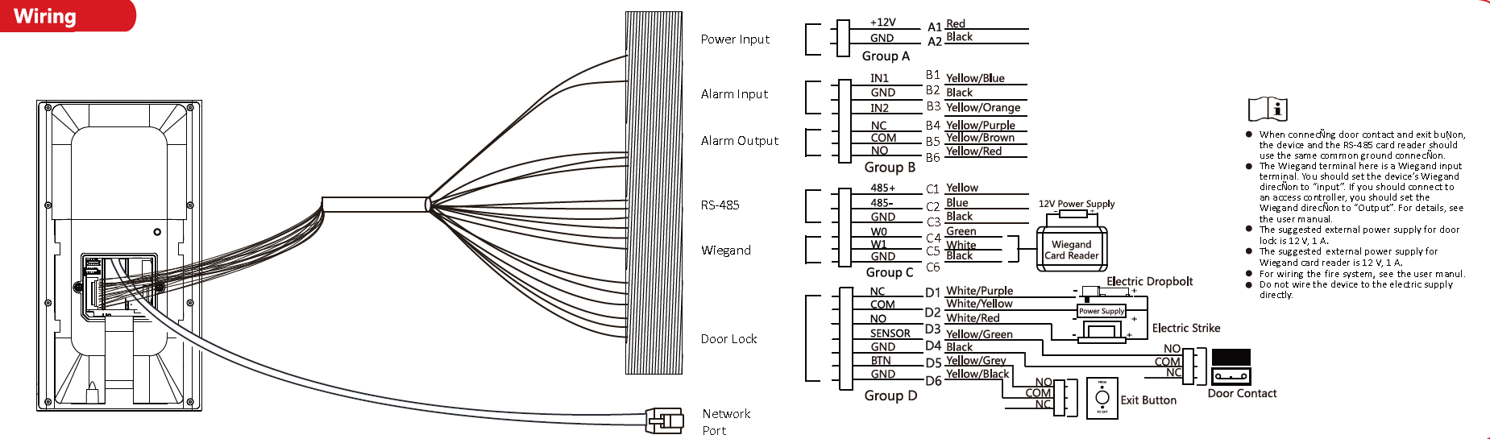
2
Wiring Wiegand cable for DS-K5671(Optional)
Wiring Instructions
Face Recognition Terminal Wiring Instructions
Optional: If card authority of turnstile is needed in access control, connect the Wiegand port to the Wiegand port of card reader in ESD Turnstile. Then the ESD turnstile card reader will be the card reader of face recognition terminal.
Note: Only K5671 face recognition terminal need this wiring, K1T671 can realize card authority by its own card reader.
Connect to RS-485 of Access Control Board in ESD Turnstile

Slide 17

2
Wiring Wiegand cable for DS-K5671(Optional)
Card Reader DIP Switch (Optional)
If card authority is needed in access control, connect the Wiegand port of Face Recognition Terminal to the Wiegand port of card reader in ESD Turnstile. Please set the DIP switch firstly before connecting the cared reader.
DIP Switch Status | Reader
0000 0100 | Wiegand 34 protocol
Card reader connect to Face Recognition Terminal as Wiegand 34 protocol, so you need to configure the binary value of the card reader as 0000 0100.
Note: Only K5671 face recognition terminal need this configuration, K1T671 can realize card authority by its own card reader.

Slide 18
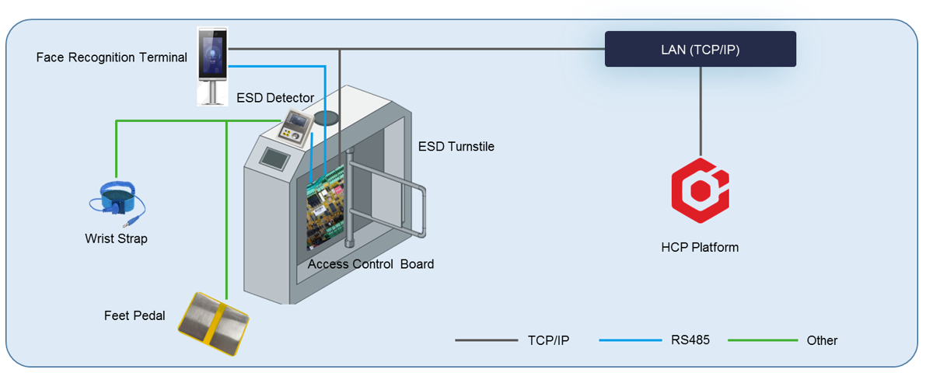
2
Installation for ESD

Slide 19
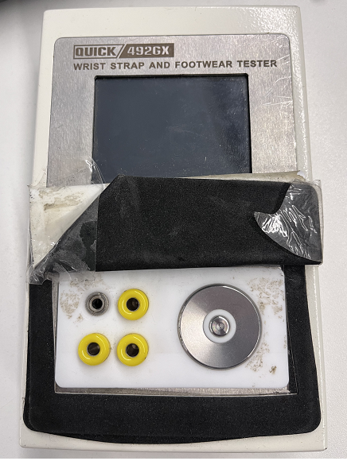
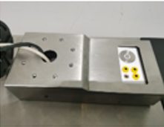
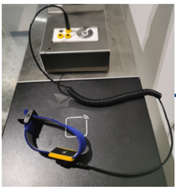
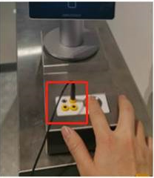
2
Wirng for ESD
Lead all the wiring cable through hole on upper cover of turnstile
Use the installation cover to fix the ESD detector on turnstile
Connect waist strap to the interface of ESD detector
Install MinMoe through installation hole on cover of ESD detector

Slide 20
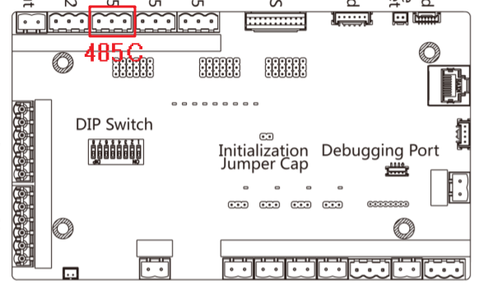
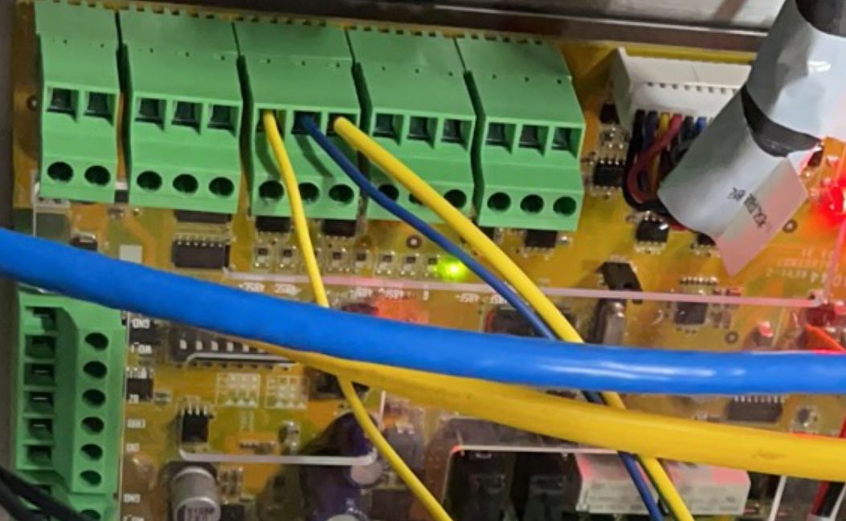
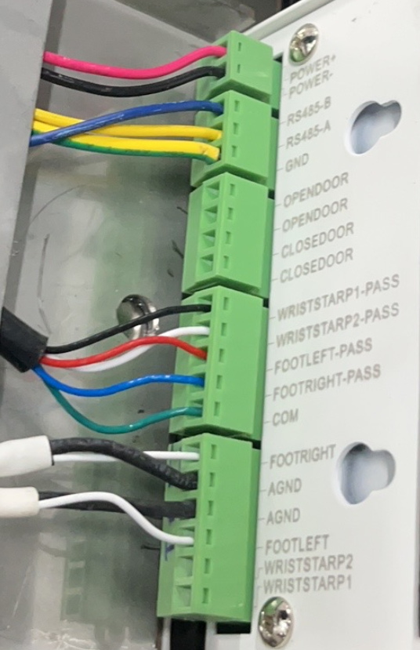
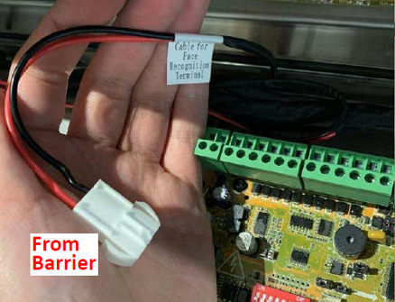
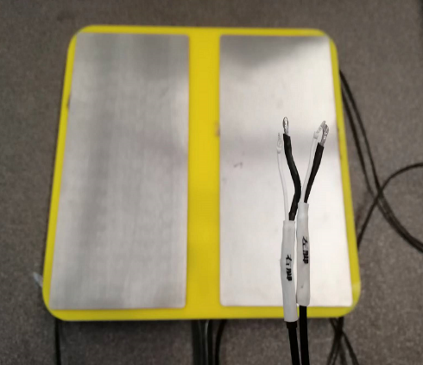
2
Wirng for ESD
+ - G
1.Connect RS485-A with RS485C+ Connect RS485-B with RS485C-
2. Connect both foot interface with foot pedal
3. Connect POWER interface with 12V power cable of turnstile

Slide 21
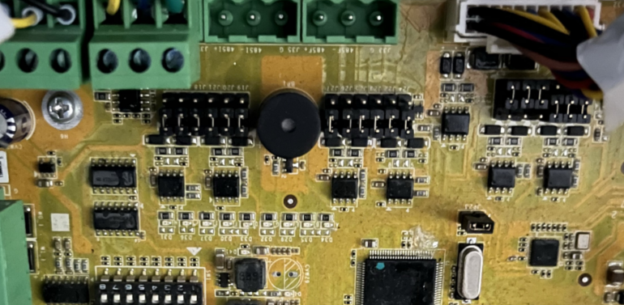
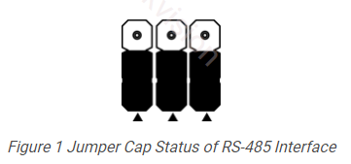
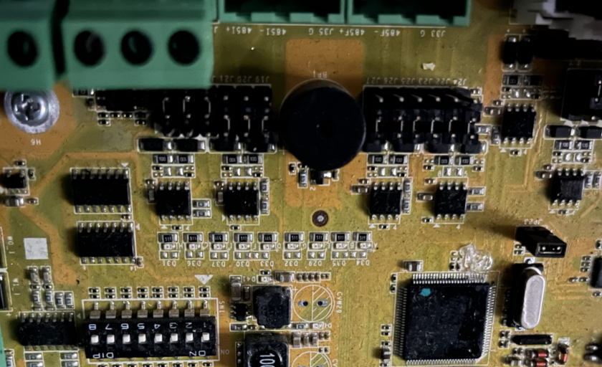
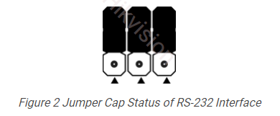
2
Wirng for ESD- RS485/232 jumper
485C is RS232 communication mode by default. Need to switch to RS-485 mode
If jumper cap’s position is like picture below(direction based on triangle), this port is in
RS-485 communication mode
If the jumper cap’s position is like the picture below(direction based on triangle), this port
is in RS-232 communication mode
RS-485
RS-232

Slide 22
3
Configuration

Slide 23
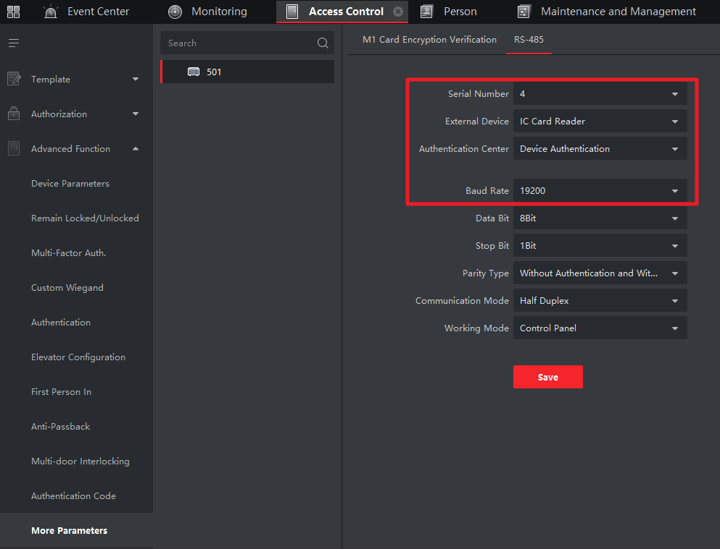
3
RS-485 configuration for turnstile
Open ivms-4200, add turnstile and go to Access Control-Advanced Function
-More parameters,choose turnstile and go to RS-485
Serial Number: choose 4 to change 485D parameters
External Device：choose IC Card Reader
Authentication Type: Device Authenticaiotn
Baud Rate: 19200 for RS-485

Slide 24
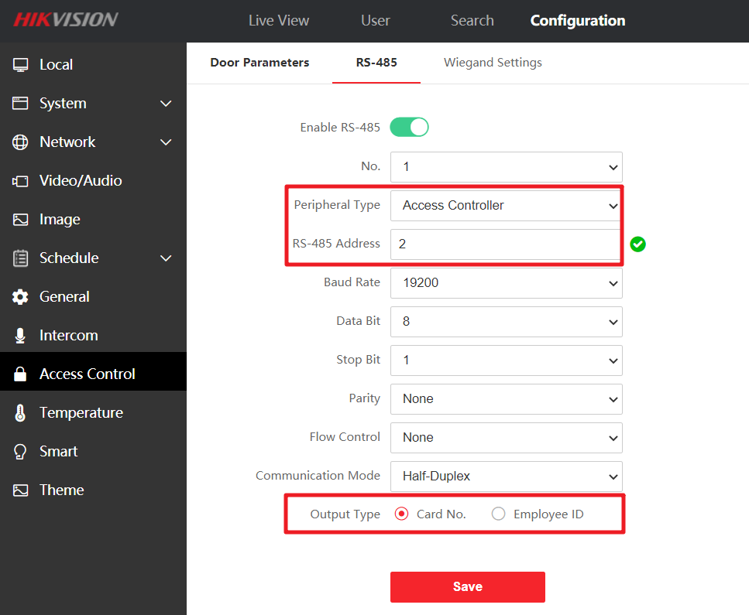
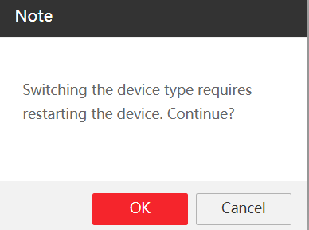
3
RS-485 configuration for MinMoe
Open web page of MinMoe, go to Configuration-Access Control-RS-485
Peripheral Type:choose Access Controller
By default is card reader, change to access controller requires reboot
Baud Rate: 19200
RS-485 Address : 2 for entrance minmoe
3 for exit minmoe
Output Type: choose Card No.

Slide 25
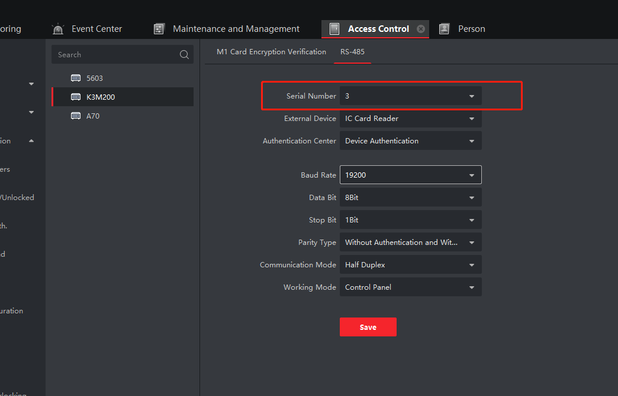
3
RS-485 configuration for ESD
Open ivms-4200, add turnstile and go to Access Control-Advanced Function
-More parameters,choose turnstile and go to RS-485
Serial Number: choose 3
External Device：choose IC Card Reader
Authentication Type: Device Authenticaiotn
Baud Rate: 19200 for RS-485

Slide 26
4
Self check

Slide 27


4
Power on & off
Power on the turnstile, wait a few seconds ,indicator turns green, device is ready
You need to manually lift middle pole after power on
Be care:
when power off, middle pole drops automatically, it might hit someone aside

Slide 28
4
Check MinMoe RS-485 status
Go to Maintenance and Management , choose Device Status –Card Reader to check 485 status
Reader 2 means entrance MinMoe; Reader 3 means exit Minmoe
If offline, need to check RS-485 wiring and RS-485 configuration of Minmoe and Turnstile

Slide 29




THANKS !
First Choice for Security Professionals

